Slide 1
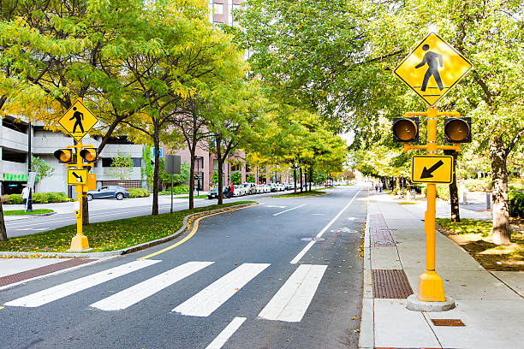
Fatal Accidents in Chicago
2019 - Present
Presented by:
Rebecca Levine
Aiden Lee
Heather Robson
Daniel Andreou
December 12, 2022
Notes:
Daniel

Slide 2
Table of Contents
Purpose Statement
The Data
Conclusion
Notes:
Daniel

Slide 3
Objective
Identify who is affected by fatal accidents in Chicago, where the accidents are taking place and when it is likely for fatal accidents to occur.
Notes:
Aiden

Slide 4
The Dataset
Dataset was obtained from the Chicago Data Portal https://data.cityofchicago.org/
The data is pulled from the Vision Zero Chicago website. As stated in the description of the dataset, “Vision Zero is Chicago’s commitment to eliminating fatalities and serious injuries from traffic crashes”. Within this data set there is a list of designated fatal accidents as defined by the Fatal Crash Response Coordination Committee (FCRCC). For a death to be appended to the list, the death has to be within 30 days of an accident involving a motor vehicle within a public right of way.
“The open data portal is required under an Executive Order signed by Mayor Rahm Emanuel on December 10, 2012.”
Notes:
Becca

Slide 5
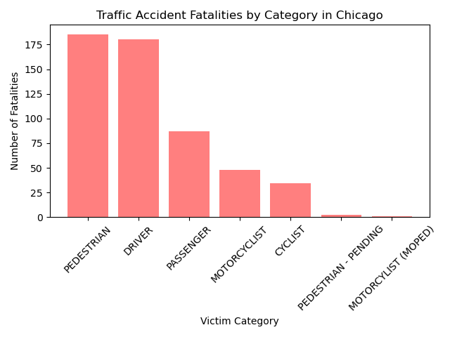
Who is affected?
537 fatal accidents have occured in Chicago since 2019
185 Pedestrians have been killed since 2019
180 Drivers have died in an accident since 2019
Notes:
Heather

Slide 6
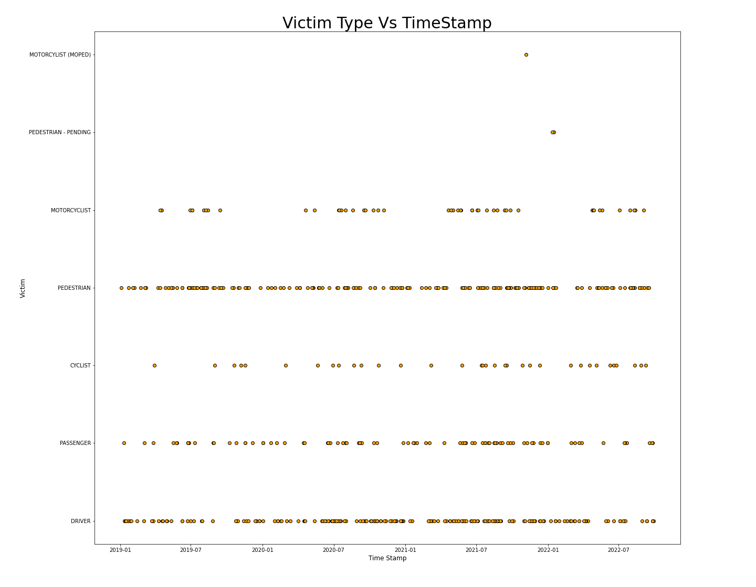
Is there a connection between victim type and when the fatality occurred?
Each Victim Type has pattern across time.
There are distinct trends surrounding changes in season for particular victim types.
Notes:
Becca

Slide 7
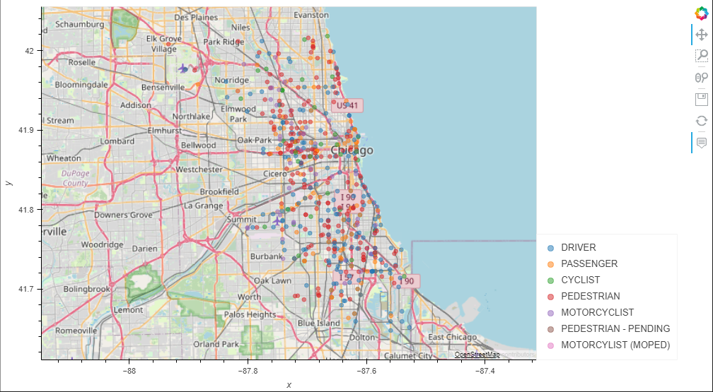
Where are these fatal accidents?
Plotted fatal accident locations across Chicago by victim category
Observed clusters:
S Stony Island merge to S Cornell near the Jackson Park Golf Course
S Pulaski and 5th Avenue
W Madison Street stretch between N Kildare & S Pulaski intersection
Notes:
Heather

Slide 8
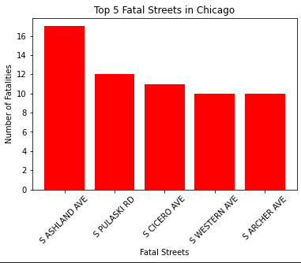
Which streets have the most fatalities?
Took the count of street names to see the amount of times each street name showed up.
S Ashland Ave - 17 fatalities, S Pulaski Rd - 12 fatalities, S Cicero Ave - 11 fatalities, S Western Ave & S Archer Ave - 10 fatalities.
Total of 60 fatalities from these streets
Majority of the streets located in the southern parts of Chicago.
Notes:
Aiden

Slide 9
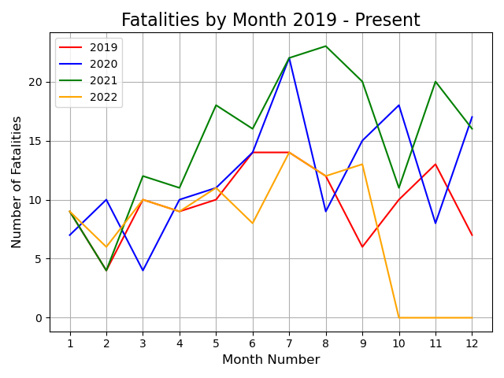
What time of the year are these accidents happening?
Worst Year: 2021
Most Fatalities: July
Biggest factors: Weather and
Covid
Limit to dataset
Notes:
Daniel

Slide 10
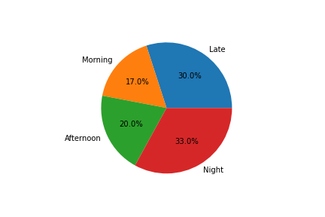
When are more fatalities occurring?
Times of day were sorted as follows:
Morning: 6 am -12 pm
Afternoon: 12 pm - 6 pm
Night: 6 pm -12 am
Late: 12 am - 6 am
Fatalities occur more frequently at night, with late trailing close behind.
Morning is the least common time.
This may be expected due to difference in visibility.
Notes:
Becca

Slide 11
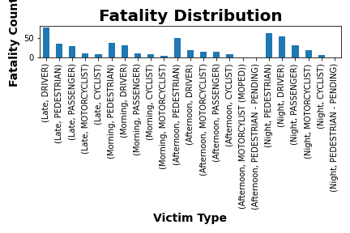
Do the trends in “When” differ by victim type?
The same trends as captured by the previous chart seem to be replicated among victim types.
While late and night have similarly larger trends, the distribution between victim types seems consistent across times as well.
Fatalities are most common for pedestrians with the notable exception of late.
Notes:
Becca

Slide 12
Conclusion
Most affected group : Pedestrians & Drivers
Most affected area : Southside of Chicago
Deadliest Street : South Ashland Ave
Worst year : 2021
Deadliest Month : July
Largest dip in Fatalities : March 2020 (COVID)
63% of fatal crashes happened between 6PM-6AM
Drivers were the most affected group between 12AM-6AM
Pedestrians were the most affected group between 6PM-12AM
Limitations of the data: This is a very general overhead look at fatal crashes in Chicago. Each case can be different and have different reasons as to why/how that person died. To dig into the causes of death to solve possible traffic infrastructure issues would require more time and a granular analysis of the required dataset(s).
Notes:
1 paragraph summarizing your findings. (Daniel and Aiden)
Mention if there are limitations to your analysis or if there is something you would have done differently. (Heather)
Improvements (Becca)

